Slide 1

Nirbhaya Naari
An Artificial Intelligence tool for detection of crime against Women
Vivekanand Education Society’s Institute Of Technology
Department Of Computer Engineering
BE Project Review
SAKSHEE SAWANT (D17B, 51) Project Mentor: Dr.‌ ‌Mrs.‌ ‌Nupur‌ ‌Giri‌ ‌
SRISHTI VAZIRANI (D17B, 66)
KHUSHI ZAWAR (D17B, 71)
DIVYA RAISINGHANI (D17A, 52)

Slide 2
INDEX
Introduction to Project
Lacuna in the existing System
Problem Statement
Literature Survey
Hardware, Software, tools and the constraints
Block Diagram of the Project (Conceptual Architecture)
Modular Diagram of the Project (Also DFD, Use Case diagram / ER Diagram)
Methodology employed
Algorithms Implemented
Implementation Details (Flowchart, GUI Screenshots, Dataset Used)
Results Obtained (Screenshots)
Conclusion
Future Scope
References
Review Sheet 1 (Semester VIII)
Details of paper Published

Slide 3
INTRODUCTION
Vivekanand Education Society’s Institute Of Technology
Department Of Computer Engineering

Slide 4
INTRODUCTION
The United Nations defines violence against women as "any act of gender-based violence that results in, or is likely to result in, physical, sexual, or mental harm or suffering to women, including threats of such acts, coercion or arbitrary deprivation of liberty, whether occurring in public or in private life.
According to the Crime in India Report 2018, published by the National Crime Research Bureau (NCRB), a crime is recorded against women in India every 1.7 minutes and a woman is subjected to domestic violence every 4.4 minutes.
This violence leads to high social and economic costs for women, their families, and societies.
The Department of Labor reports that victims of violence lose nearly 8 million days of paid work per year in the U.S., resulting in a $1.8 billion loss in productivity for employers.

Slide 5
LACUNA
Vivekanand Education Society’s Institute Of Technology
Department Of Computer Engineering

Slide 6
LACUNA
Although there are government laws that ensure severe punishment to the abusers after the occurence of crime but no such system that keeps check on the abusers.
Lack of awareness among women concerning their rights and laws.
No system that confirms that the women is suffering from violence through their stories.

Slide 7
PROBLEM DEFINITION
Vivekanand Education Society’s Institute Of Technology
Department Of Computer Engineering

Slide 8
PROBLEM DEFINITION
“Nirbhaya Naari” is a model that detects possible violent actions against women and thus, is useful in controlling women's safety.
Our idea provides a forum for women to speak out against abuse, as well as uses continuous real-time surveillance to detect any kind of violence and “help hand gestures” via which women can request assistance at any moment.
Our solution strives to identify and respond to physical, sexual, psychological, and verbal acts of abuse/violence against women. This solution also provides a platform for women to speak out against violence while simultaneously seeking help.

Slide 9
LITERATURE SURVEY
Vivekanand Education Society’s Institute Of Technology
Department Of Computer Engineering

Slide 10
LITERATURE SURVEY
Sr. No. | Title of the paper | Authors | Briefings
1 | Robust Real-Time Violence Detection in Video Using CNN And LSTM. | Abdali, A.-M. R., & Al-Tuma, R. F. | In this work, they presented a real-time violence detector based on deep-learning algorithms in this study. With a focus on the three-factor model, the suggested model comprises of CNN as a spatial feature extractor and LSTM as a temporal relation learning technique (overall generality -accuracy - fast response time).
2 | “American Sign Language Alphabet Recognition by Extracting Feature from Hand Pose Estimation” | Shin, J., Matsuoka, A., Hasan, M., & Srizon | In this work, the media-pipe hands algorithm was used for estimating hand joints from RGB images of hands obtained from a web camera and two types of features were generated from the estimated coordinates of the joints obtained for classification
3 | “Early Detection and Prevention of Domestic Violence Using the Women Abuse Screening Tool (WAST) in Primary Health Care Clinics in Malaysia” | Yut-Lin W, Othman S. | This is a cross-sectional study to identify domestic violence among female adult patients.The findings suggested that primary care can play an important role in detecting domestic abuse by using the WAST screening instrument, or a suitable adaptation of it, with women patients during routine visits to various health clinics

Slide 11
LITERATURE SURVEY
Internal Complaints Committee(ICC) - Women
The Ministry of Women and Child Development launched an online complaint management system called Sexual Harassment electronic -Box (She-Box) for registering complaints about sexual harassment at work. The She-Box is a platform for women working or visiting any Central Government office to file complaints related to sexual harassment at work under the Sexual Harassment of Women at Work (Prevention, Prohibition and Redressal) Act, 2013.
SHEROES
Sairee Chahal developed SHEROES, a women-only community that offers a safe and trusting area. Women can talk about many elements of their lives here, such as health, careers, and relationships, as well as share their life stories, accomplishments, and memorable moments. It gives women a place to talk about their experiences. It also assists them with counselling hotlines and professional referrals.

Slide 12
LITERATURE SURVEY
The laws under Section 354 state that: Any man commits to assault or use of criminal force to woman with intent to outrage her modesty or knowing it to be likely that he will thereby outrage her modesty, shall be punished with imprisonment or fined or both. The law protects against
A) Sexual harassment
B) Using assault or criminal force on a woman with intent to disrobe her
C) Voyeurism
D) Stalking
Sexual harassment is considered a violation of a woman’s fundamental right to equality, which right is guaranteed by Articles 14 and 15 of the Constitution
Similarly, the laws under Section 509 declares that: uttering any word or making any gesture intended to insult the modesty of a woman will lead to imprisonment for three years and a fine

Slide 13
HARDWARE, SOFTWARE, TOOLS USED
Vivekanand Education Society’s Institute Of Technology
Department Of Computer Engineering

Slide 14
HARDWARE, SOFTWARE, TOOLS USED
Language: Python 3
IDE: Jupyter notebook
Modules/Packages:
1. Scikit learn
2. Numpy
3. Matplotlib
4. Pandas
5. Keras
6. TensorFlow
Framework:
1. Django
Deployment:
1. AWS
Cloud Resources:
1. Amazon AWS

Slide 15
BLOCK DIAGRAM
Vivekanand Education Society’s Institute Of Technology
Department Of Computer Engineering

Slide 16
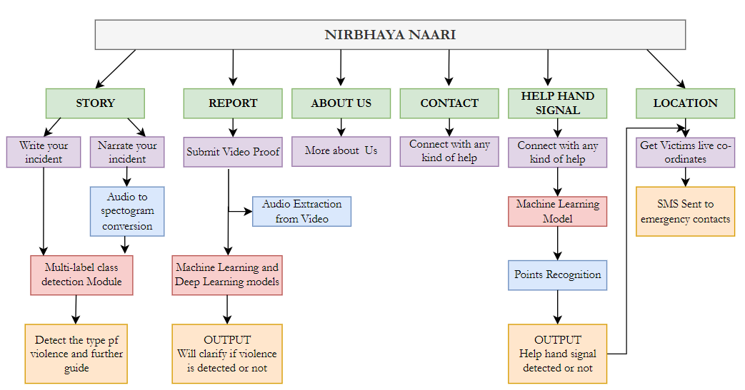
BLOCK DIAGRAM

Slide 17
DEPLOYMENT DIAGRAM
Vivekanand Education Society’s Institute Of Technology
Department Of Computer Engineering

Slide 18
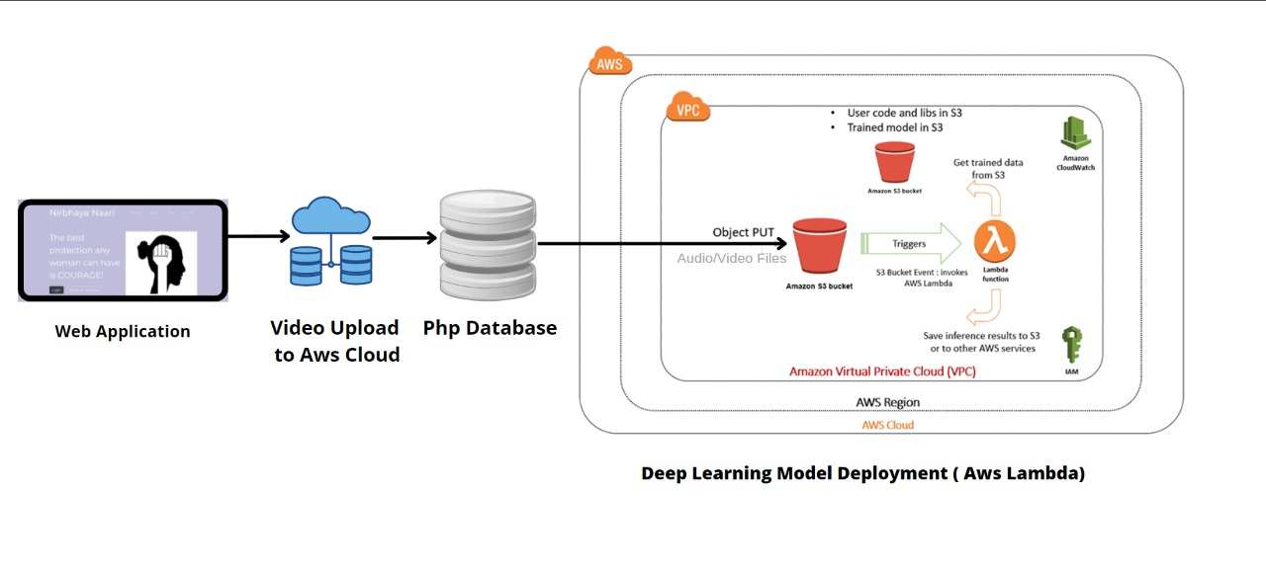
DEPLOYMENT DIAGRAM

Slide 19
MODULAR DIAGRAM
Vivekanand Education Society’s Institute Of Technology
Department Of Computer Engineering

Slide 20
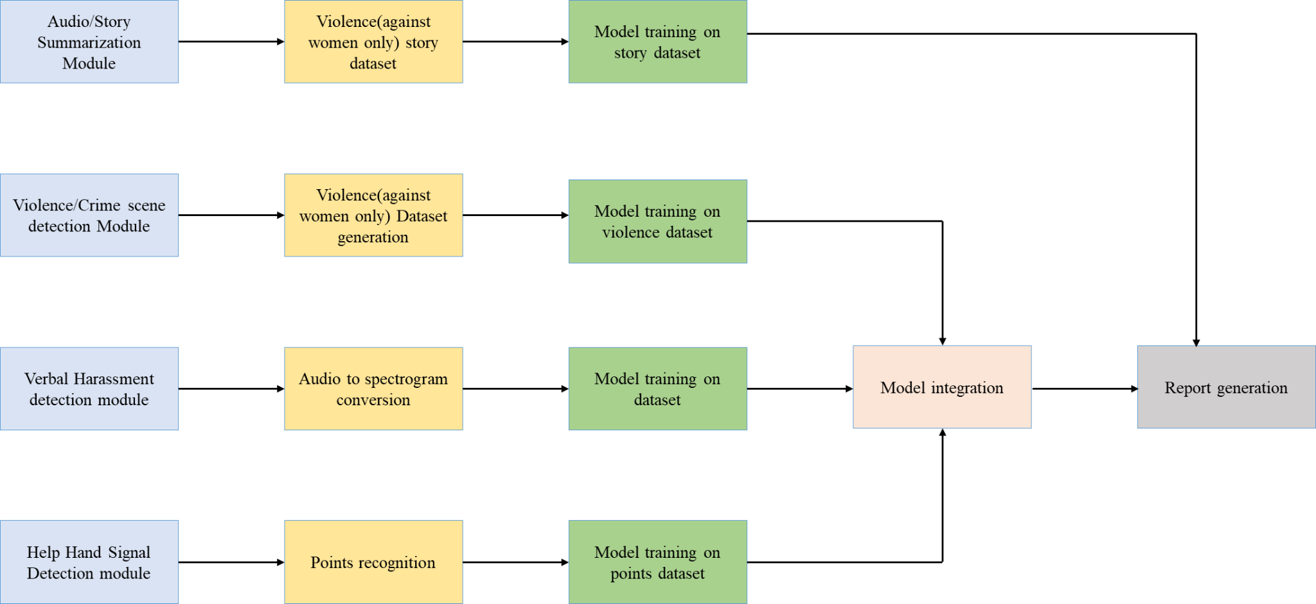
MODULAR DIAGRAM

Slide 21
DATA FLOW DIAGRAM
Vivekanand Education Society’s Institute Of Technology
Department Of Computer Engineering

Slide 22
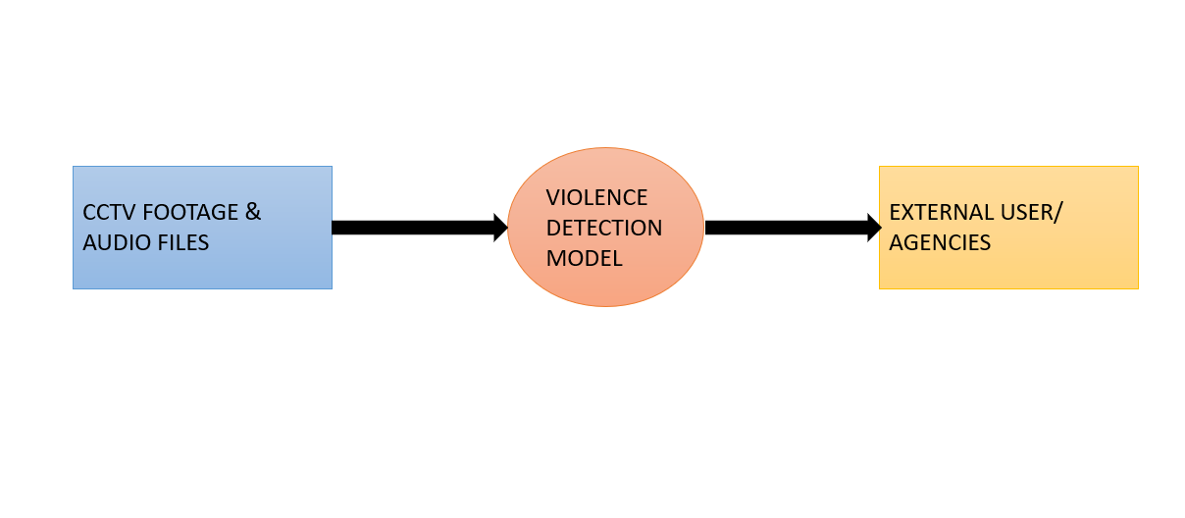
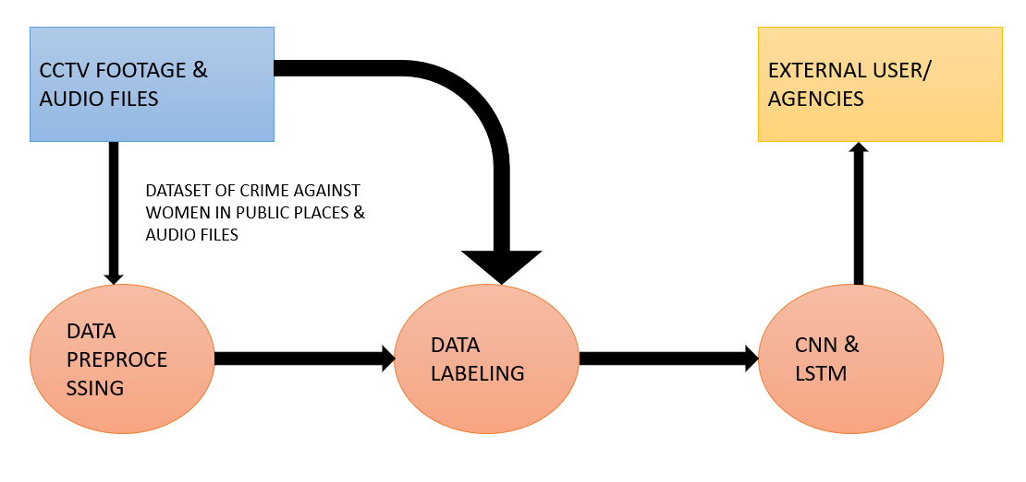
DATA FLOW DIAGRAM
Fig: DFD Level 0
Fig: DFD Level 1

Slide 23
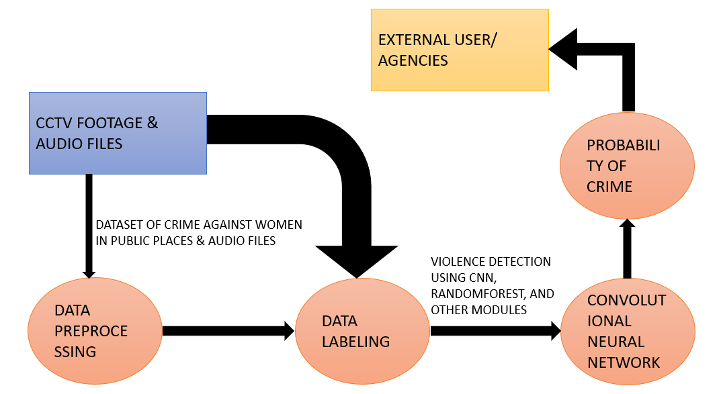
DATA FLOW DIAGRAM
Fig: DFD Level 2

Slide 24
METHODOLOGY
Vivekanand Education Society’s Institute Of Technology
Department Of Computer Engineering

Slide 25
METHODOLOGY
● There are three main modules: Violence/Crime Scene Detection against women, audio-video conversion and detection of Verbal Harassment or Verbal Help Detection and, Help Hand Signal Detection.
● The probability value will be derived from all the three models.
● If a threshold value is crossed, the authorities will be alarmed automatically.
Audio-Video conversion and detection of Harassment:
1. Audio to MFCC Conversion
2. SVM (Support Vector Machine) model and MPN (Multilayer perceptrons model) training over sounds dataset
3. CNN and LSTM model training on the crime dataset

Slide 26
METHODOLOGY
Help Hand Signal Detection:
1. The model includes an input layer, three convolution layers, as well as ReLu and max
pooling layers for feature extraction
2. One softmax output layer, and a final fully connected output layer for gesture classification
Multi-label classification of stories:
1. Audio file to text conversion
2. Used domain specific word embeddings to get more accurate results
Report Generation:
1. Profiling
2. Database Generation

Slide 27
ALGORITHM IMPLEMENTED
Vivekanand Education Society’s Institute Of Technology
Department Of Computer Engineering

Slide 28
ALGORITHM IMPLEMENTED
The system detects violence from both video and audio. The finalized system consists of 4 subsystems:
1) Audio/Story Summarization Engine
2) Violence detection engine for audio/video
3) Help hand signal detection
4) Multi-label classification of stories
The multi-label classification used for identifying the type of violence a woman has gone through. We used domain specific embeddings and pre-trained embeddings also.
Multilayer perceptrons model of Deep learning is used for audio classification. Seamlessly glue together the video classification and audio classification models for greater detection rates.

Slide 29
IMPLEMENTATION DETAILS
Vivekanand Education Society’s Institute Of Technology
Department Of Computer Engineering

Slide 30
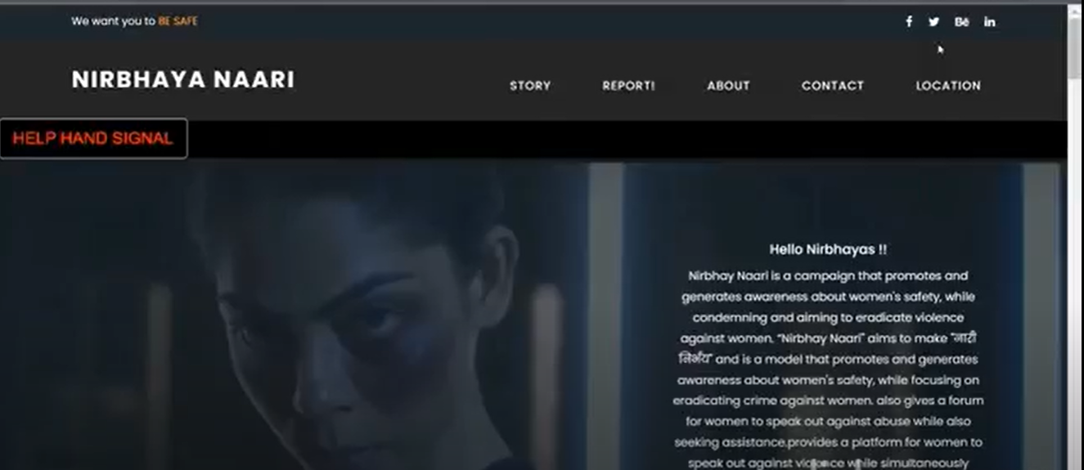
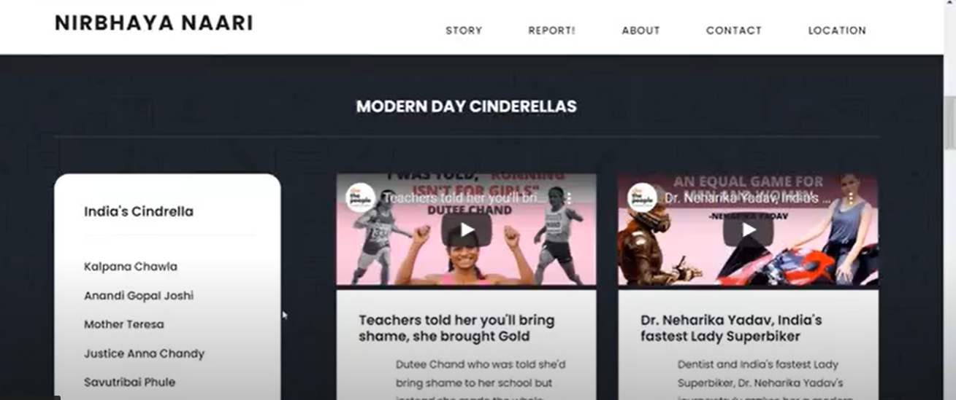
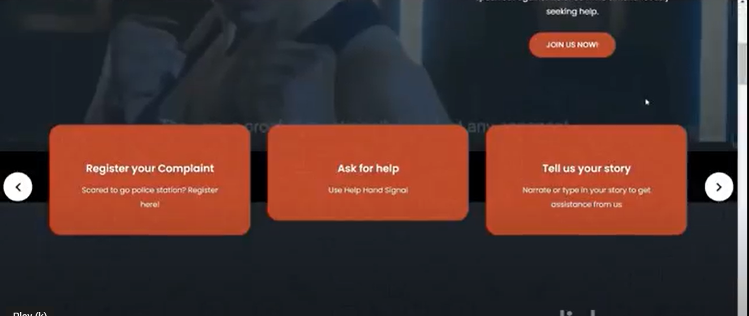
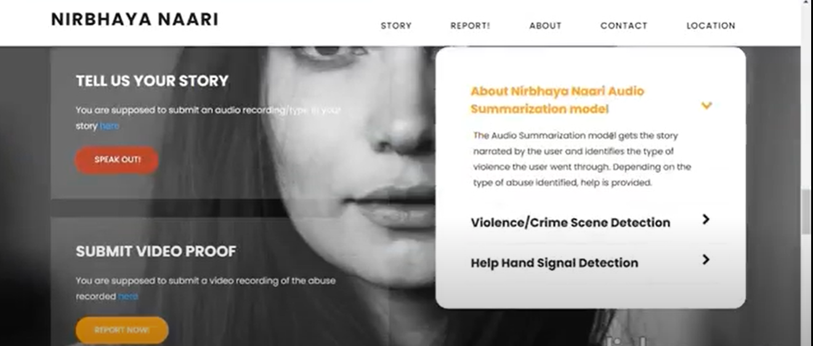
IMPLEMENTATION SCREENSHOTS

Slide 31
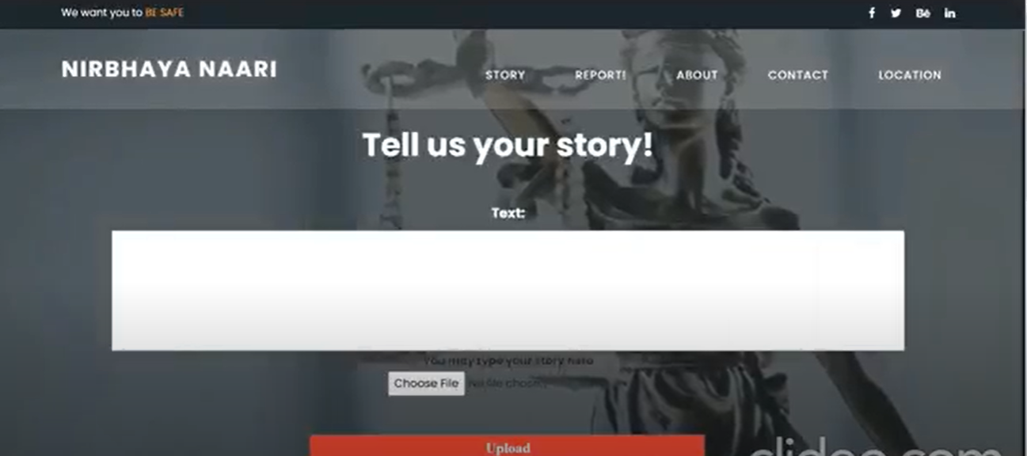
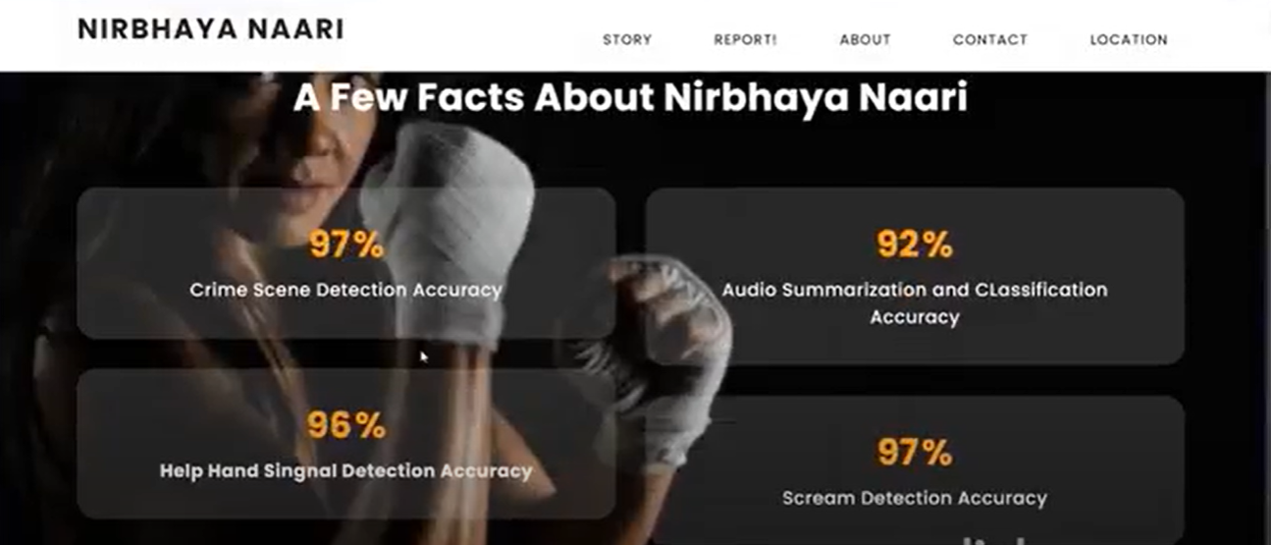
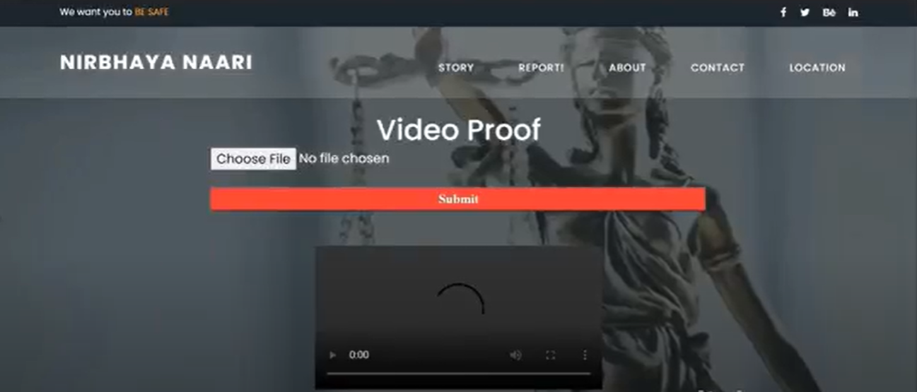
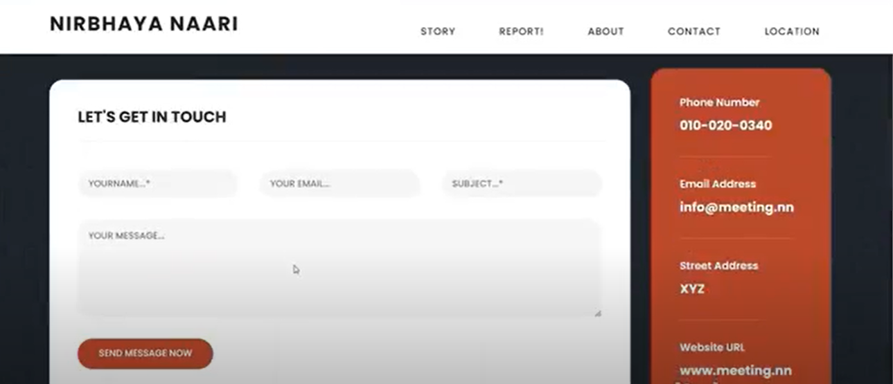
IMPLEMENTATION SCREENSHOTS

Slide 32
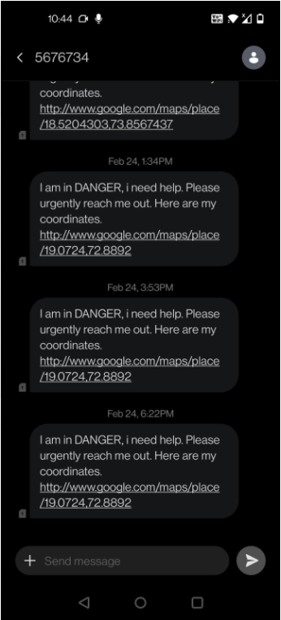
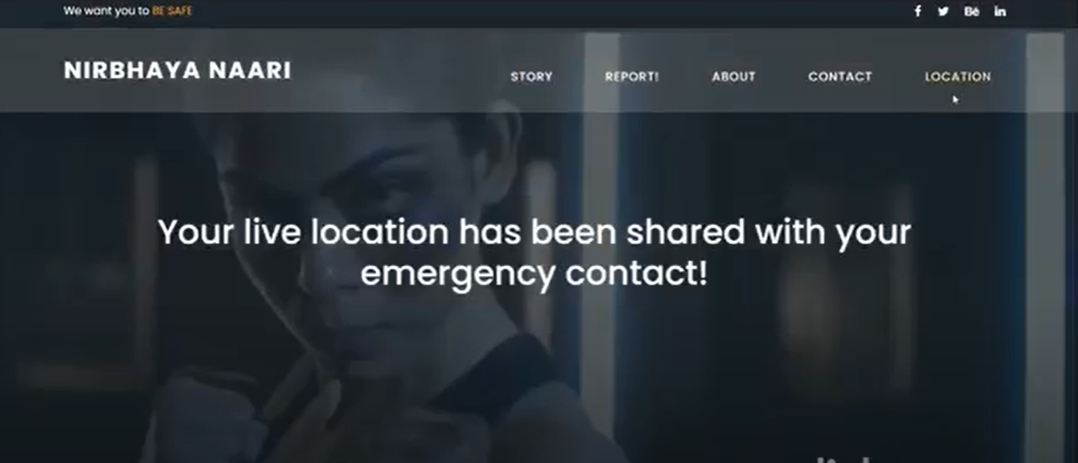
IMPLEMENTATION SCREENSHOTS

Slide 33
RESULTS OBTAINED
Vivekanand Education Society’s Institute Of Technology
Department Of Computer Engineering

Slide 34
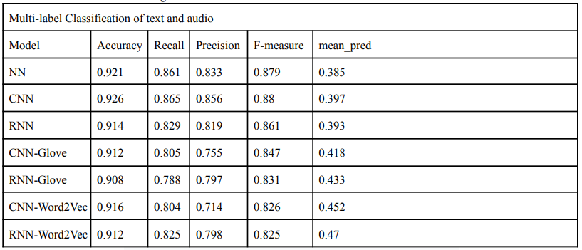
RESULTS

Slide 35
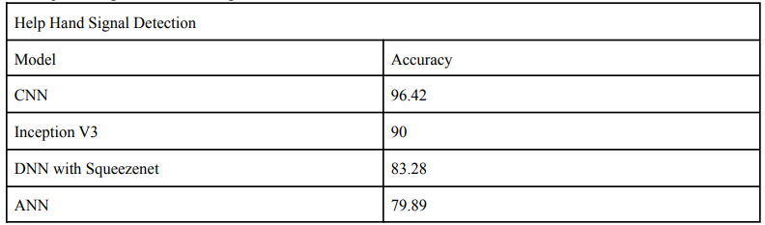
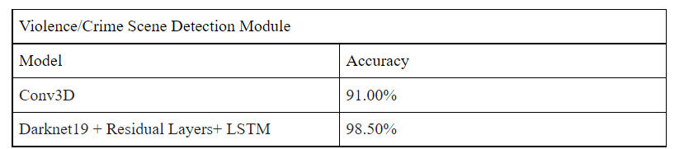
RESULTS

Slide 36
FUTURE SCOPE
Vivekanand Education Society’s Institute Of Technology
Department Of Computer Engineering

Slide 37

FUTURE SCOPE
Tying-up with the local NGOs
Facilitate multilingual interaction to ensure that language does not become a barrier
Robust and reliable live CCTV security system.
Today Alexa is a humble servant, but tomorrow
she could be a rescuer

Slide 38
CONCLUSION

Slide 39
CONCLUSION
A platform where women can raise their voices and experience safer environment
Our project will instil terror in the minds of the abusers before they do any acts of violence
Acts as an aid to ICC
Reduction in crime rates
Women empowerment
Mental well being of females which in turn increases their growth in both personal as well as professional life
Applied for SERB POWER GRANT PROPOSAL

Slide 40
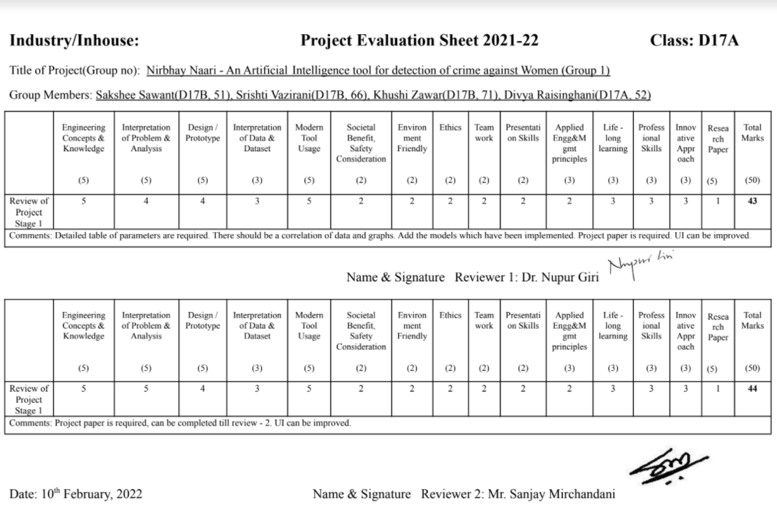
REVIEW SHEETS

Slide 41
REFERENCES
Vivekanand Education Society’s Institute Of Technology
Department Of Computer Engineering

Slide 42
REFERENCES
[1] United Nations. Declaration on the elimination of violence against women. New York: UN, 1993.
[2] Violence against women Prevalence Estimates, 2018. Global, regional, and national prevalence estimates for intimate partner violence against women and global and regional prevalence estimates for non-partner sexual violence against women. WHO: Geneva, 2021
[3]https://www.thehindu.com/data/data-domestic-violence-complaints-at-a-10-year-high-during-covid-19-lockdown/article31885001.ece
[4] https://www.who.int/news-room/fact-sheets/detail/violence-against-women
[5]http://www.niti.gov.in/making-homes-safer-women-during-covid-19
[6]https://womenchild.maharashtra.gov.in/content/homecontent/schemes.php
[7] https://doi.org/10.1155/2014/267872
[8] R. Johnson and T. Zhang, ‘‘Effective use of word order for text categorization with convolutional neural networks,’’ in Human Lang. Technol., Annu. Conf. North Amer. Chapter ACL, Denver, Colorados, 2014, pp. 103–112.
[9] Y. LeCun, L. Bottou, Y. Bengio, P. Haffner, "Gradient-based learning applied to document recognition", Proc. IEEE, vol. 86, no. 11, pp. 2278- 2324, 1998.
[10] A. S. Razavian, H. Azizpour, J. Sullivan, and S. Carlsson, "CNN Features Off-the-Shelf: An Astounding Baseline for Recognition," The IEEE Conference on Computer Vision and Pattern Recognition (CVPR) Workshops, pp. 806-813,2014.
[11]https://www.naaree.com/domestic-violence-helplines-india/
[12]https://www.wgea.gov.au/take-action/family-domestic-violence

Slide 43
THANK YOU
Vivekanand Education Society’s Institute Of Technology
Department Of Computer Engineering

